Slide 1
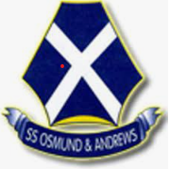
The History of
St Osmund’s RC Parish
&
SS Osmund & Andrew’s
RC Primary School

Slide 2
“The God of Heaven He helpeth us and we are His servants. Let us rise up and build.” – Esdras 2. 20

Slide 3
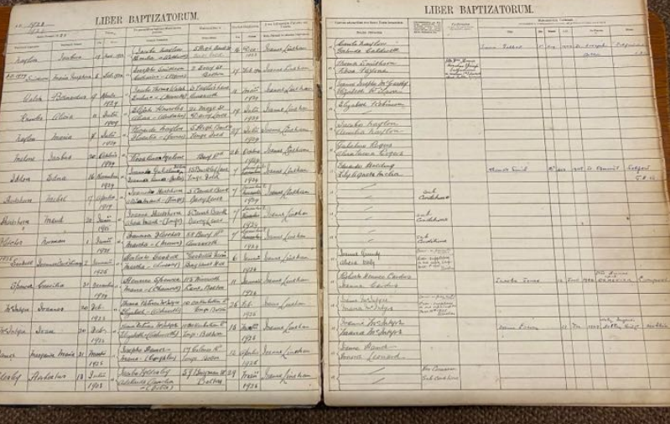
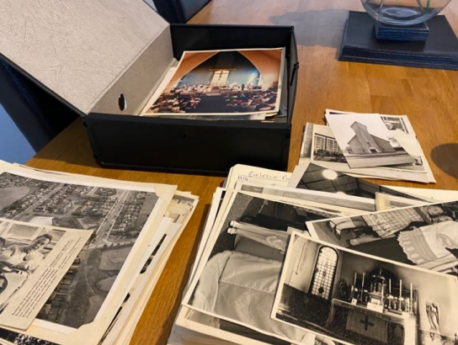
First Hand Evidence
In order to research history and timeline

Slide 4
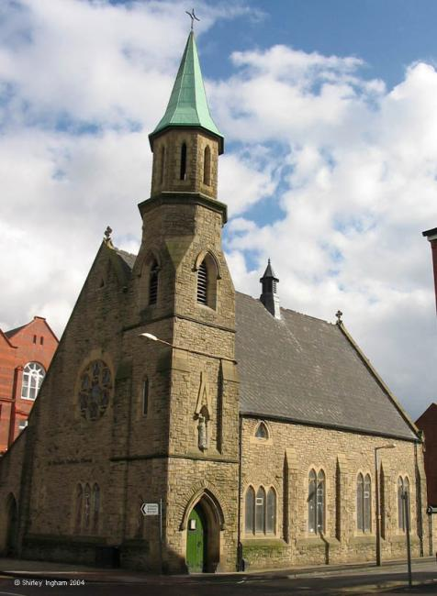
1913 Canon Osmund Woods
109 years ago in June 1913, Canon Osmund Woods the parish Priest of St Patrick’s (Great Moor Street) Bolton rented a room in a village cottage in Darcy Lever, to be used as a Sunday School where lessons could be given to the Catholic children attending non-Catholic schools in the Breightmet/Darcy Lever area.
St Patrick’s RC Church, Great Moor Street, Bolton

Slide 5
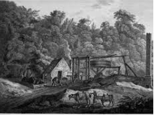
4th August 1914
A joiner’s shop at the mouth of a coal pit, was, through the generosity and enthusiasm of the Catholics of the district, transformed into a Chapel of Ease to St Patrick’s. Holy Mass for the first time in Long Lane was offered on 4th August 1914

Slide 6
St Osmund’s an independent parish.
November 1923 St Osmund’s was established as an independent Parish.
In 1923 Bishop Casartelli appointed Father J. Linehan as the first Parish Priest. Having neither church, nor school, nor presbytery, nor the site for the available buildings, Father Linehan, with the kind permission of Major C. I. Scowcroft, continued to use the building in Long Lane for Holy Mass and Sunday school.

Slide 7
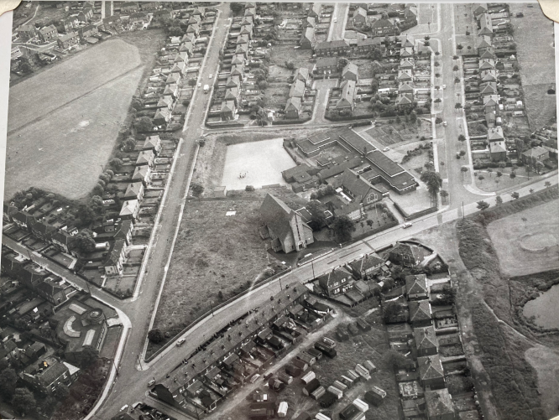
Plot of land bought in April 1924
In April 1924 John Brown bought and presented to the Salford Diocese a plot of land measuring more than four acres in area, and costing a thousand guineas. As Fr. Linehan had no Presbytery, he was the guest at Bradley Fold of John Brown a generous benefactor of the church.

Slide 8
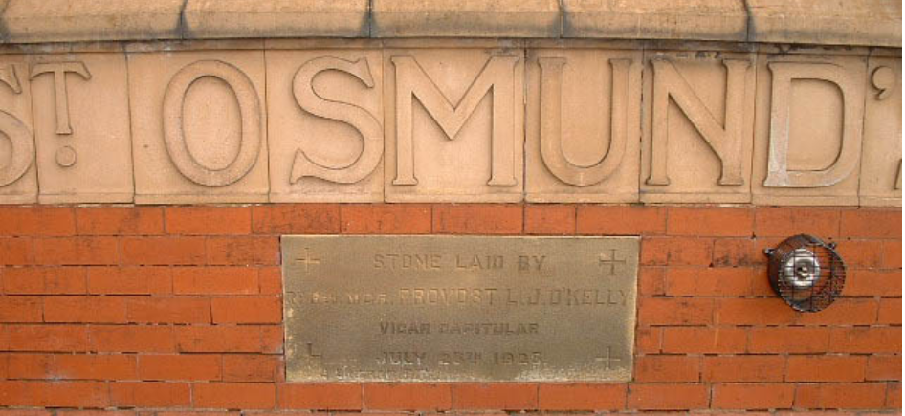
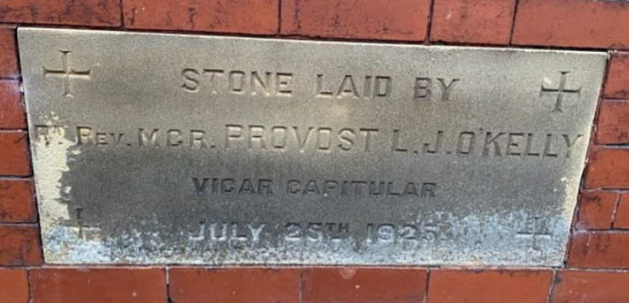
In December 1924 a house was bought, No 18 St James Avenue to be a temporary Presbytery.
On Saturday 25th July 1925 the Vicar Capitulars Mgr. Provost O’Kelly blessed and laid the foundation stone of the temporary church/school Chapel on Long Lane

Slide 9
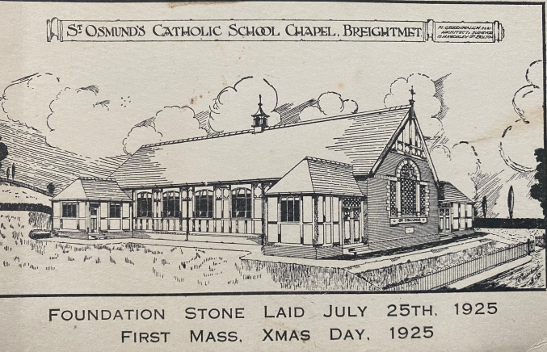
First hand evidence found on a postcard. Saturday, July 25, 1925, when Provost O'Kelly blessed and laid the foundation stone of the new church. That this event was possible in less than two years from the inception of the parish is a great tribute to the faith and courage of a small congregation.

Slide 10
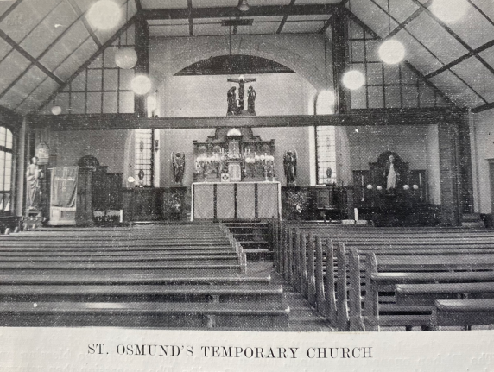
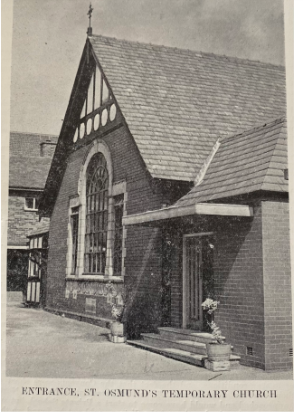
A Parochial hall was built. The excavating of the foundations and the setting of the bricks was done voluntarily by the men of the parish and the Hall was opened on December 4th1926. This was the inside of St Osmund’s temporary school and chapel.

Slide 11
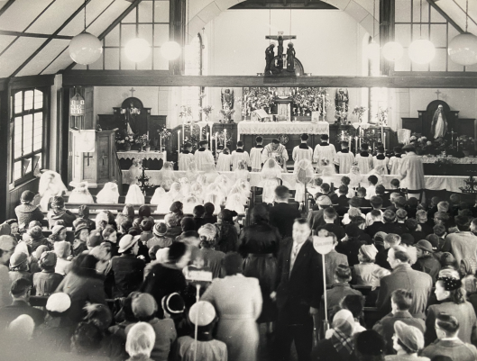
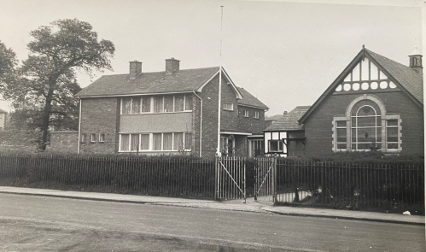
Mass said inside St Osmund’s
temporary chapel (St Osmund’s
Parish Hall)
In 1927 Fr. Charles Crisp was
appointed
In 1935 Fr. Hubert Fielding was
appointed.
During 1936 new houses were
being built on Long Lane. This
was the first attempt to obtain a
school for the Children of the
Parish of St Osmund.
In the 1953’ number 18 St James Ave was sold and the Parish Priest moved into the Presbytery next to St Osmund’s
temporary church

Slide 12
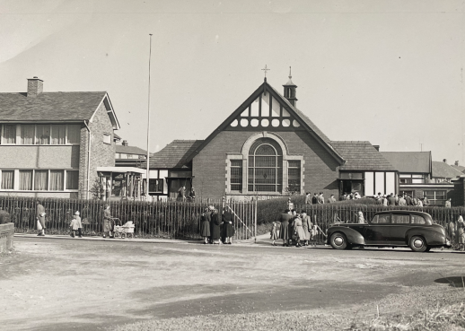
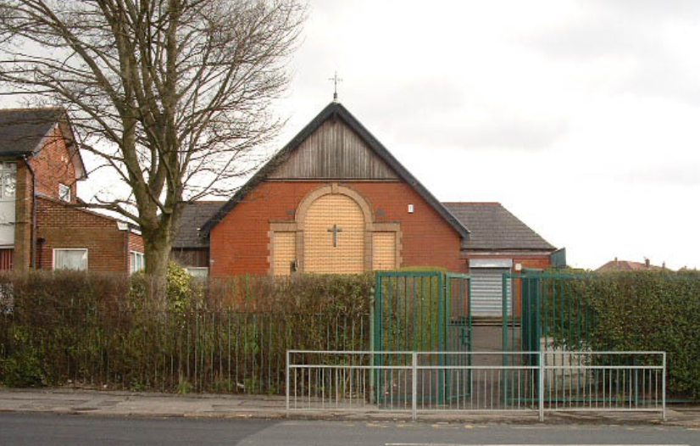
Today it is used as a church hall and function room. The stain glass windows have been bricked up at the front and shutters have been erected since. On the photo you can see that the school which would have been to the right of this temporary St Osmund’s school and chapel is no longer there.

Slide 13
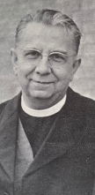
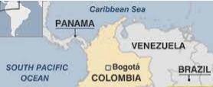
In October 1940 Fr. John Meaher succeeded Fr. Fielding
In 1942 Fr. John Anthony Weston appointed as temporary administrator, but a few weeks later the Bishop appointed him as Parish Priest. He remained parish priest till 1977. (35 years!)
Father Anthony Weston was parish priest of St Osmund's Bolton and was created Honorary Canon of the Salford Chapter when, with Bishop Holland, he attended the Eucharistic Congress in Bogota, Columbia. For Canon Weston this was a journey home. He was born in Columbia (South America) and came to England as a boy, not even speaking English. After continuing his education at Xaverian College, Manchester, he offered himself for the priesthood in the Salford Diocese.
Key priest at St Osmund’s
RC Church.
Fr. J. A. Weston later
Canon Weston

Slide 14
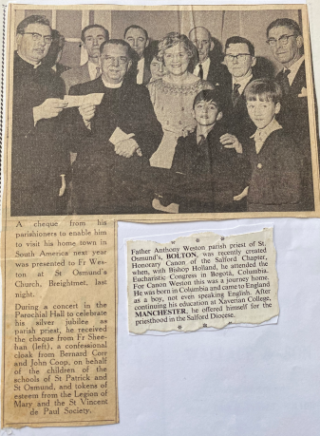
First hand evidence from old newspapers

Slide 15
Father Anthony John Weston
May 1942 Fr. Weston’s immediate concern was for the Catholic education of the children. Sixty per cent of whom were attending non-Catholic schools. He wanted to use the parish hall as a temporary school and plans were sent by the Bolton Education Committee to the Board of Education in London. The application was refused one of the reasons being stated that the premises proposed was not suitable.
In 1943 Fr. Weston tried again. An interview was granted by the board of Education in offices of the Board, Belgrave Square, London. Fr. Weston took with him, The chief Education Officer of Bolton, The Chairman of the Bolton Education Committee, Councillor Barlow and Canon Chronnell, who all journeyed to London for the meeting, which lasted two and a half hours. Once again his application was refused although he had the names of 217 children needing a school were presented to the ministry. However no doubt this interview paved the way for the establishment of a permanent school after the war when many houses were built in the area and the Catholic population greatly increased.

Slide 16
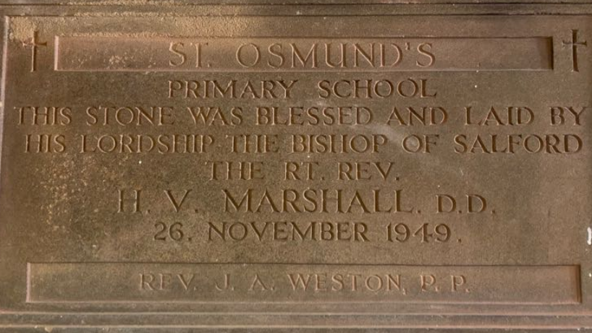
October 1948 – At last great news! because of the increasing number of houses on the estates in the vicinity, the Bolton Education Committee had been able to convince the Ministry of Education of the need for a Catholic School in Breightmet, Bolton.
1949 Final plans were sent for approval to the Ministry and in November the foundation stone was blessed and laid by the Right Reverend H. V. Marshall Bishop of Salford.

Slide 17
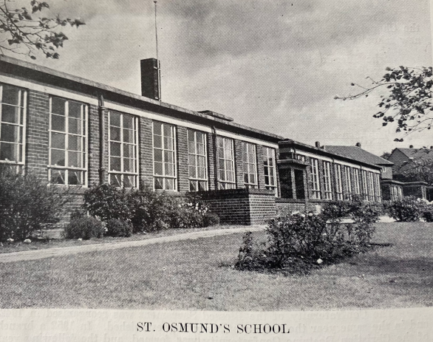
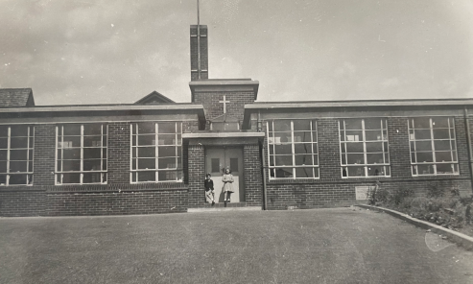
1951 St Osmund and St Patrick’s RC Primary School opened with one hundred and sixty four pupils.
At the time the Bishop stated the school was to be a joint school for St Patrick’s and St Osmund’s parishes, as the cost would be too heavy for one parish alone. When the school had opened for some time the Bishop decided that it should now be a one-parish school as most of the children belonged to St Osmund’s parish. So was renamed
St Osmund’s RC Primary School. Mr Bleasedale was the Head Master

Slide 18
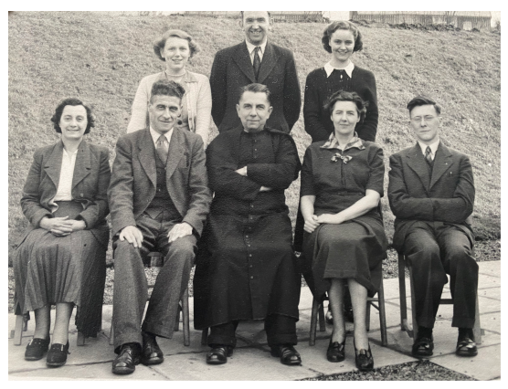
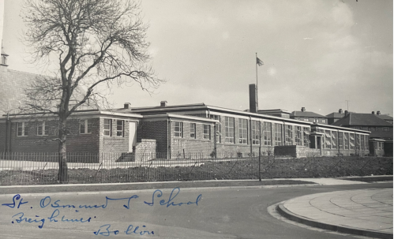
St Osmund’s RC newly built primary school
Past St Osmund RC Primary school teachers
with Canon J. A. Weston

Slide 19
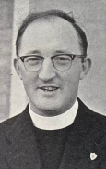
Fr. J Christie
1955 Fr. W Keane was appointed and later Fr. J Christie to assist Fr. Weston
In August 1955 a petition was sent and application made to the local education authority for the extension of the parochial hall to prevent the using of the church for school purposes. The dining and medical rooms were already being used as classrooms!
The hall extension was completed in 1957
In 1957 plans for another Primary School were being prepared, so great was the increase in the number of children due to the building of houses on the Breightmet Hall Estate, that the Ministry of Education gave permission for the building of a new auxiliary Primary School for St Osmund’s parish.

Slide 20
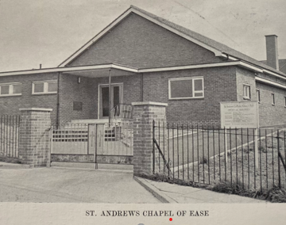
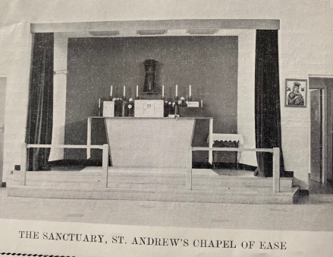
On August 9th 1958 the foundation stone of a Chapel of Ease dedicated to St Andrew was laid.
On August 29th 1959 St Andrew’s Chapel of Ease was blessed and opened by the very Reverend S. Delaney. R. D deputizing for the Bishop. From September 1959-1960, two classes were held in the chapel of Ease to relieve the overcrowding in St Osmund’s until the new school was ready

Slide 21
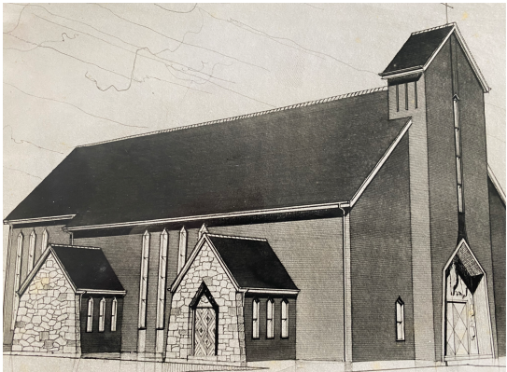
October 1959 after the opening of St Andrew’s Chapel of Ease the final plans of the permanent new Church of St Osmund’s was submitted by the Architects. Messrs. Greenhalgh and Williams. Messrs Caton & Duckworth of Blackburn, were chosen to build the church. The estimated cost was £33,749.
February 1960 building of the Church began.

Slide 22
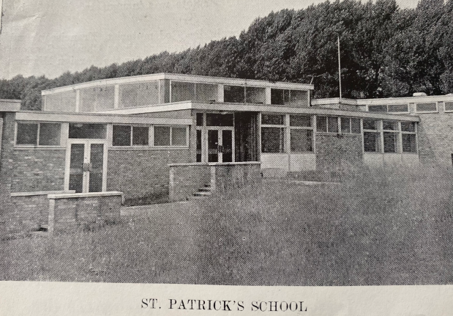
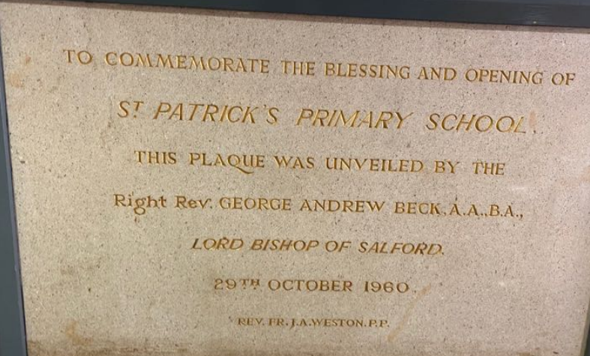
On October 29th 1960 St Patrick’s school opened later to be re-named St Andrew’s RC Primary School in 1975.
The new school was built on a site in Withins Drive and was dedicated to St Patrick, in recognition of the aid given to St. Osmund’s by the Parish Priest of St Patrick’s Father Ford and to perpetuate the name of St Patrick’s old school which was closed. The Head Master appointed at St Andrew’s RC primary was Mr Winstanly.

Slide 23
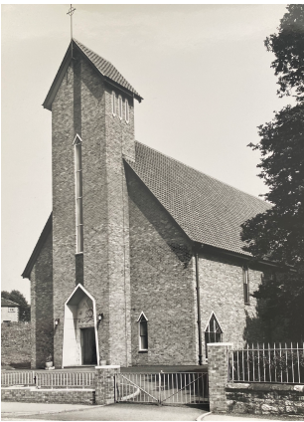
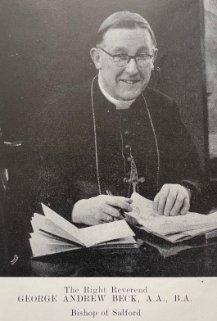
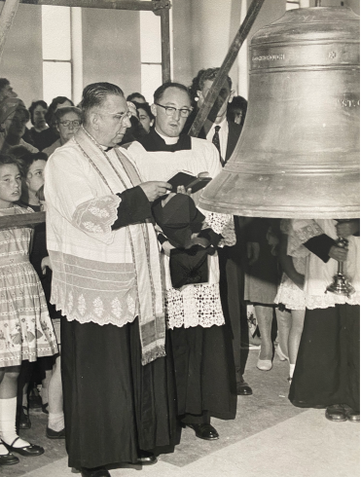
St Osmund’s RC Church, Bolton
28th September 1961 St Osmund’s RC Church was opened by Bishop of Salford. The Right Reverend George Andrew Beck.

Slide 24
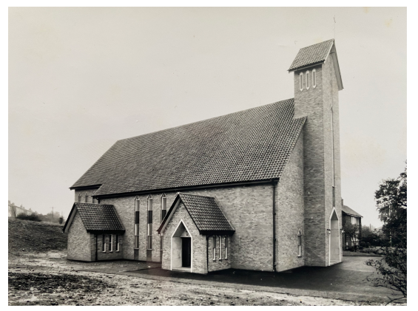
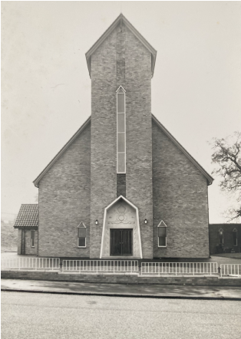
St Osmund’s RC Church 1961

Slide 25

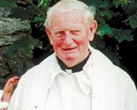
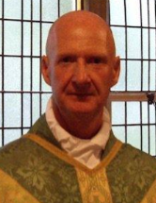

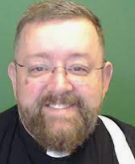
St Osmund’s RC Church 1961 - Parish Priests
Parish Priests who served the parish after the church was built:
1942 – 1977 Fr. J. A. Weston Emirates (retired)
1976 Fr. D Haley
1968 Fr. D Sheahan
1977 -1993 Fr T. B. Quilter
1993 - 2003 Fr. G. Murphy
2003 – 2005 Fr. J. Clarke
2005 – 2017 Fr J. Hilton

Slide 26
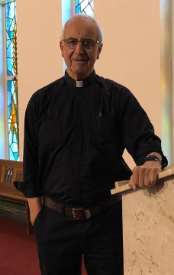
2017 – Present Fr. D. Heakin
Father Dermot Heakin was ordained on the 21/06/1975 at Salford Cathedral by Bishop Holland. Father Heakin was born in Salford, one of nine children. His brother Leo is also a priest ordained in 1969.
Father spent six years from 1984-90 as a Missionary Priest in the Diocese of Kisumu in Kenya. In his spare time Father enjoys sailing, kayaking, windsurfing and playing the guitar.
Father Heakin lives at the Presbytery at St Osmund’s and celebrated his third anniversary at St Osmund’s Parish on 30th April 2020 and became Parish Priest for St Teresa’s in October 2019 when the churches amalgamated to form the Parish of Blessed Dominic Barberi.

Slide 27
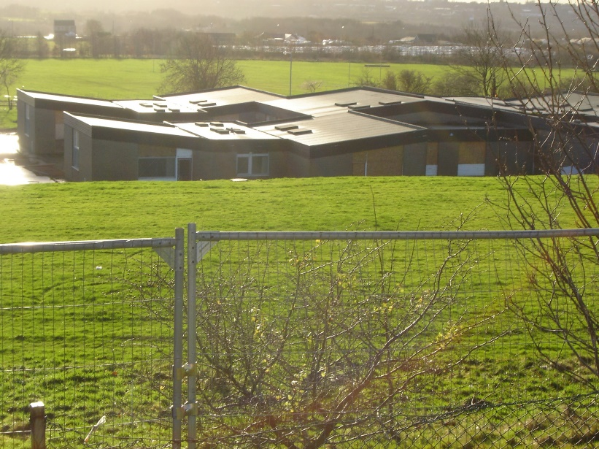
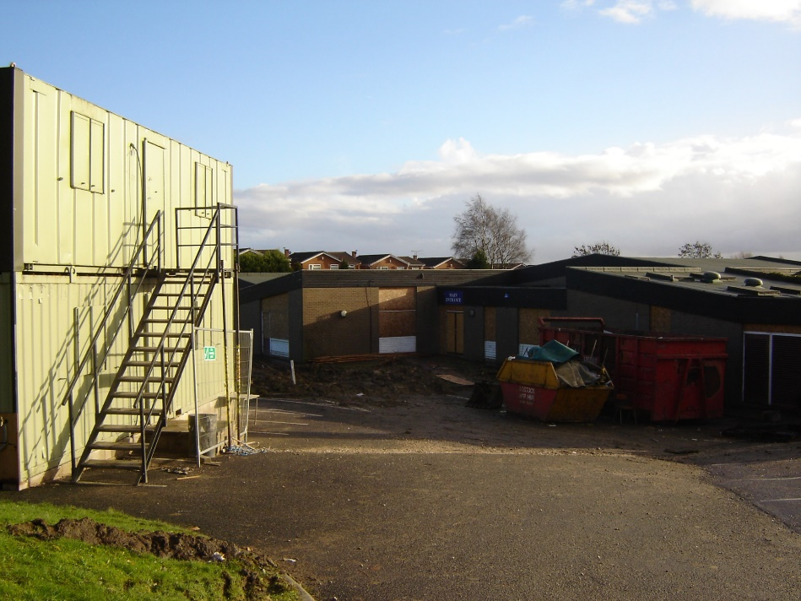
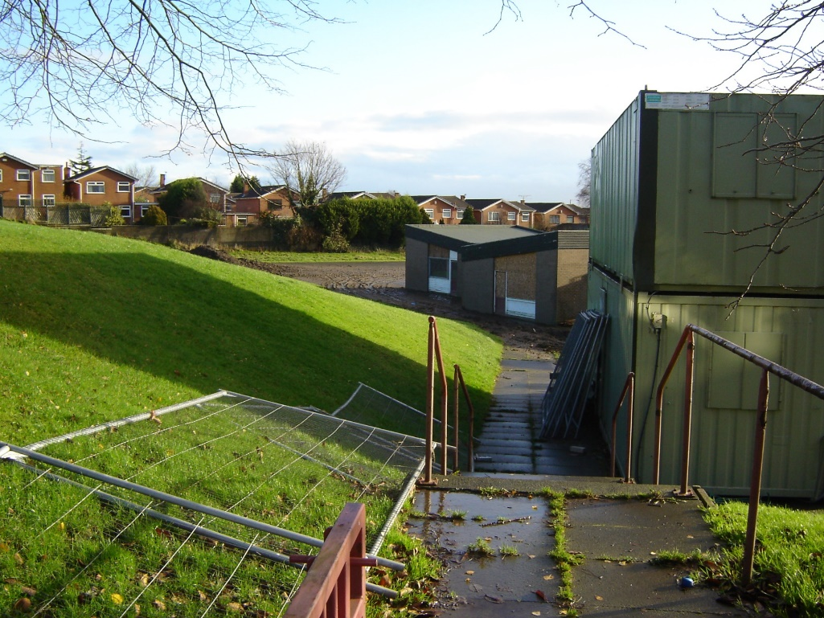
The Moss Primary school before the builders came…

Slide 28
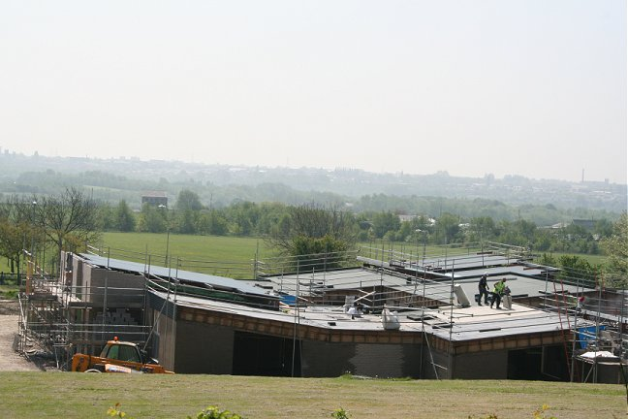
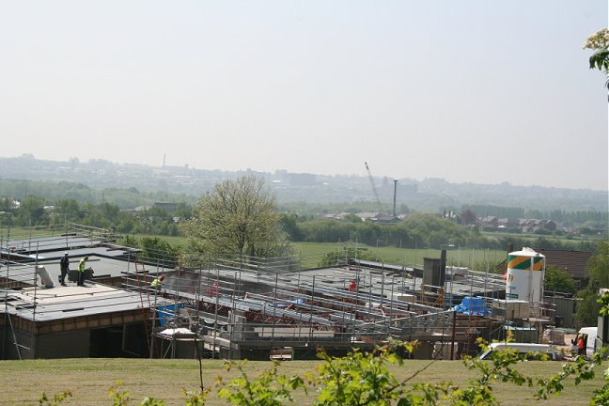
Building our new school
SS Osmund & Andrew’s RC Primary School

Slide 29
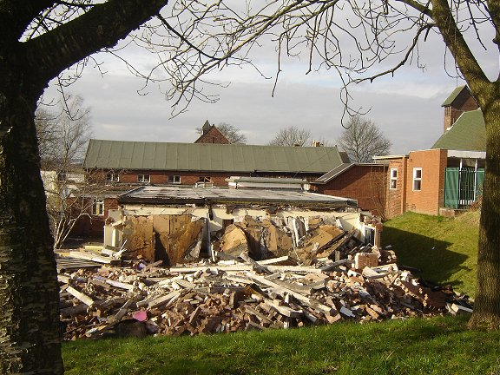
Knocking down St Osmunds

Slide 30
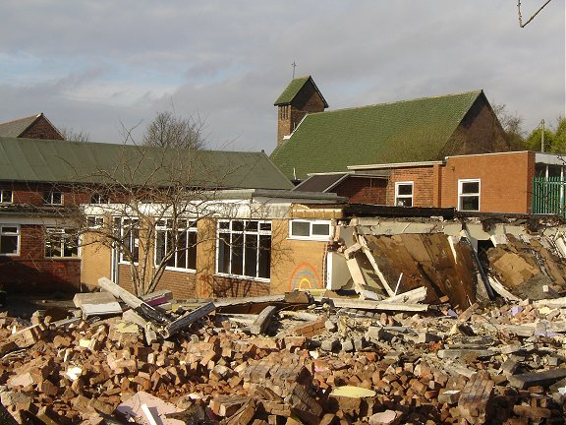

Slide 31
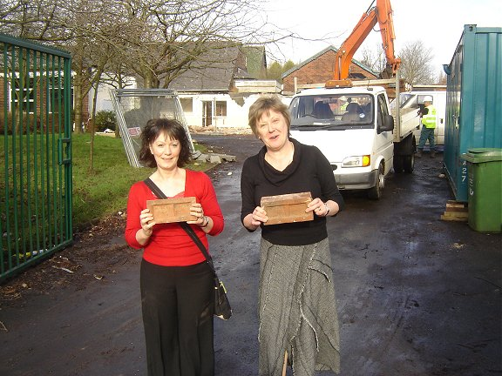

Slide 32
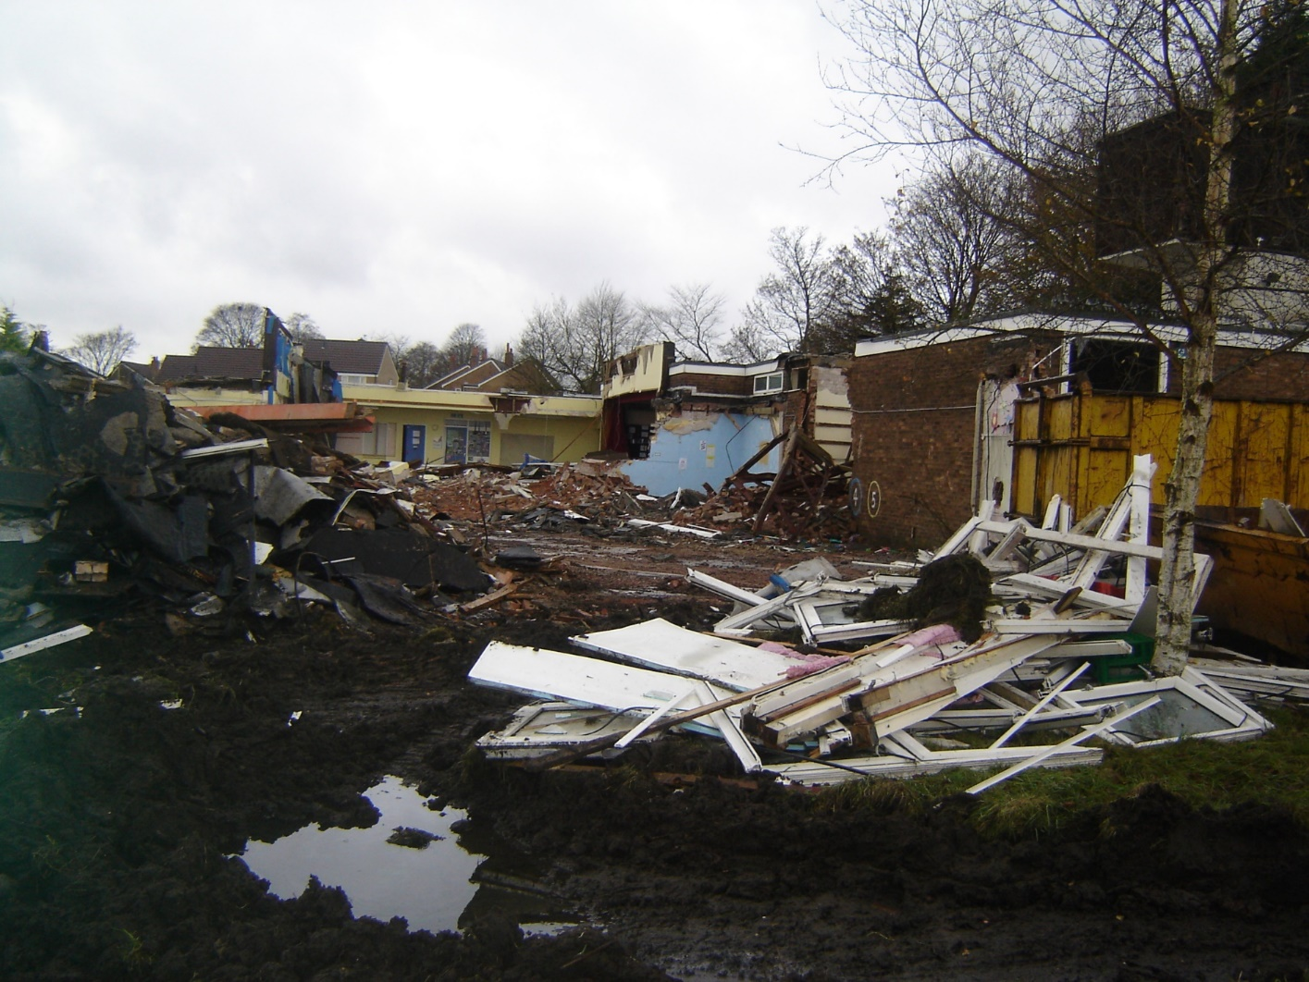
Knocking down St Andrews

Slide 33
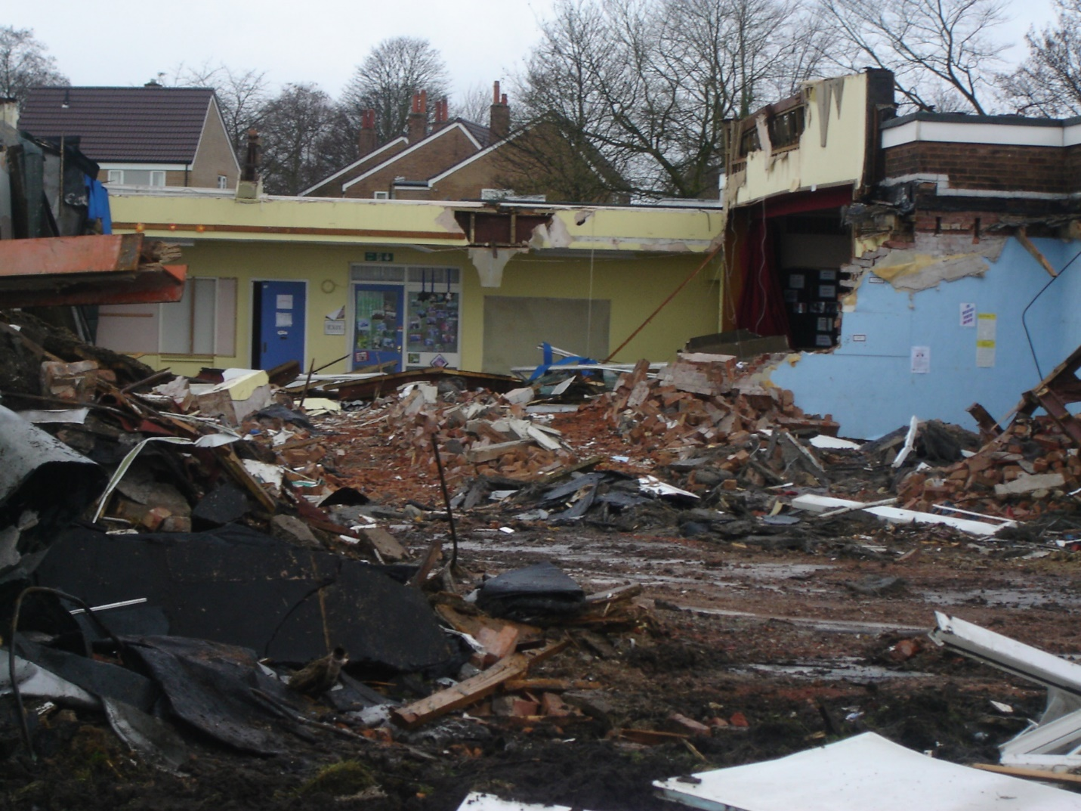

Slide 34
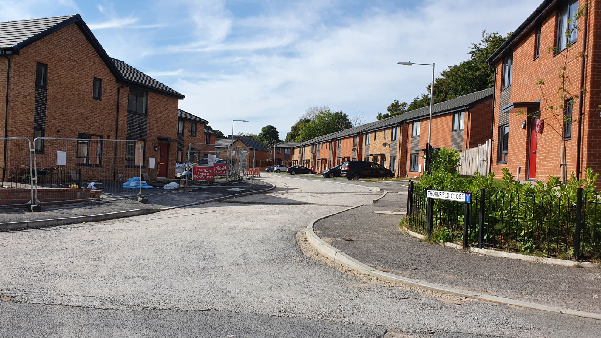
St Andrews site now…

Slide 35
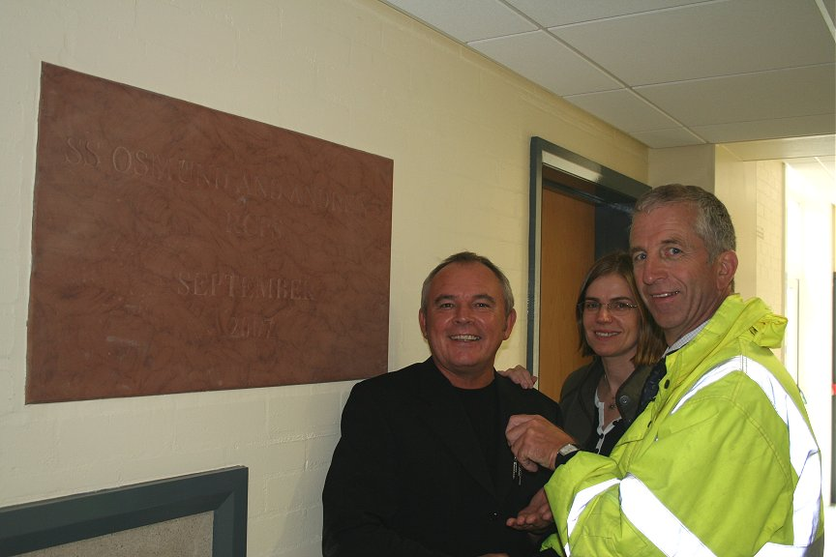
Builders handing over the keys to the Head Master
Mr Thorpe

Slide 36


In 2007 the two schools St Osmund RC Primary and St Andrew’s RC Primary from the old sites amalgamated and became
SS Osmund & Andrew’s RC Primary School

Slide 37


Opening of the new school

Slide 38

Our first assembly for
SS Osmund & Andrew’s RC Primary School

Slide 39

SS Osmund & Andrew’s RC Primary School
September 2007, Mr John Thorpe was the
first Head Master at this new site and he
was instrumental in looking after both sites
before both schools amalgamated at the
Falkirk Drive site.
Mr Thorpe retired in July 2015 and Mrs Julie
McDonald was appointed in Sept 2015,
She retired in July 2020 and in Sept 2020
Mr James Graves took up the post as the
Current Head of the school.

Slide 40
Past St Osmund RC Primary school teachers
with Canon J. A. Weston

Slide 41

Some of the present teachers at
SS Osmund & Andrew’s RC Primary School with Fr. D. Heakin

Slide 42
Timeline of St Osmund Parish:
1913 Canon Osmund Wood rented a room in Darcy Lever as a Sunday school
August 1914 – Holy Mass was said for the first time in Long Lane
Nov 1923 – St Osmund’s was established as an independent Parish.
Fr. J Linehan was appointed as first parish priest.
April 1924 Plot of land bought and presented to Salford Diocese
Dec 1924 No 18 St James Ave bought as a temporary presbytery
4th Dec 1926 – Parochial hall (St Osmund’s temporary School and Chapel) was built.
1927 – Fr Charles Crisp was appointed
1935 Fr. Hubert Fielding was appointed
1936 New houses were being built
1940 Fr. John Meaher was appointed

Slide 43
Timeline of St Osmund Parish:
1942 Fr John Anthony Weston was appointed as Parish Priest
May 1942 plan sent to Bolton Education Committee for Catholic school refused.
1943 – 2nd application for school refused again.
1948 – Ministry of Education agreed for the need for a Catholic School in Breightmet, Bolton
Nov 1949 – Foundation stone was blessed and laid for St Osmund & St Patricks school
Sept 1951 St Osmund and St Patrick’s RC Primary School opened. Later it was changed by the Bishop to St Osmund’s RC primary school to be a one parish school.
1955 – Fr. W. Keanne and Fr. J Christie appointed to assist Fr. J. A. Weston
1955-1957 petition to extend the parochial hall and completed.

Slide 44
Timeline of St Osmund Parish:
Aug1959 St Andrew’s chapel of Ease blessed and opened.
Oct 1959 Final plans of the permanent new church of St Osmund’s was submitted
Feb 1960 Building of St Osmund’s Church began
Oct 1960 St Patrick’s school in Withins Drive opened later to be renamed St Andrew’s
Sept 1961 St Osmund’s RC Church was opened by Bishop Beck
1968 Fr D Sheahan was appointed to assist Fr. J. A. Weston
1972 The Moss Primary school on Falkirk Drive opened.
1976 Fr D Haley was appointed

Slide 45
Timeline of St Osmund Parish:
1977-1993 Fr. T. B. Quiilter appointed
1993-2003 Fr. G. Murphy to assist Fr. T. B. Quilter
2002 The Moss Primary School closed.
2003-2005 Fr. J. Clarke appointed
2005 – 2017 Fr. J. Hilton appointed
Sept 2007 SS Osmund & Andrew’s RCP School opened at new site. Amalgamation of both schools - St Osmund’s and St Andrew’s primary school, located at the building which used to be “The Moss Primary School” on Falkirk Drive site opened.
April 2017 Fr. D. Heakin was appointed as Parish Priest
Oct 2019 Fr. D. Heakin became Parish Priest for St Teresa’s when the churches amalgamated to form the Parish of Blessed Dominic Barberi.
2020 Mr Graves was appointed as our current Head Master

